Slide 1
Extension of interaction paradigms
AIST3510 Tutorial 9
Instructor: Professor Helen Meng, Professor Philip Fu
TA: Ka-Hei Hui
Acknowledgement: This slide deck is adapted from the version edited by Mr. Disong Wang and other previous instructors and TAs.

Slide 2
Outline
Development of display technology
Display characteristics
Advanced display technology
Input interfaces

Slide 3
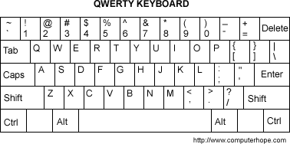
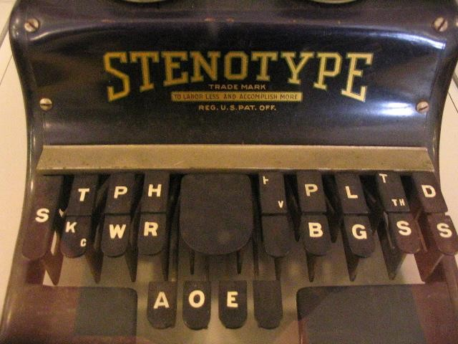
Input interfaces: text -- keyboard
QWERTY keyboard vs. stenotype
Which is faster?
QWERTY keyboard: more keys but simple
Stenotype: designed for stenographers, require special training

Slide 4
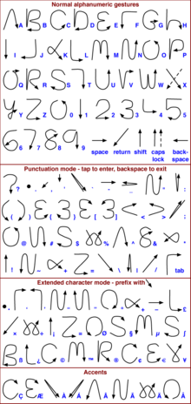
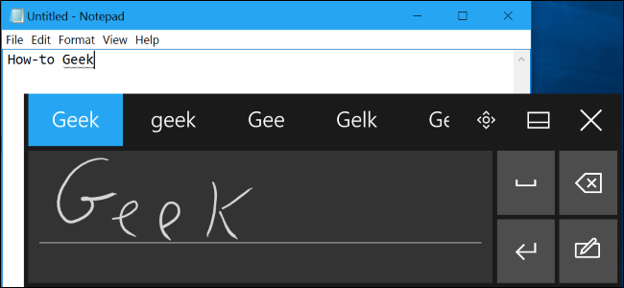
Input interfaces: text -- handwriting
Handwriting Recognition in Windows 10
Graffiti system used by Palm OS and others

Slide 5
Input interfaces: text -- handwriting
Surface Pro Handwriting Recognition Demo:
https://www.youtube.com/watch?v=PHvzBRe7hIc

Slide 6
Input interfaces: text -- speech
Continuous speech recognition
General text entry
E.g. Dictation in iOS
Spoken command recognition
Give commands to the system
Navigation Commands for Windows 10: https://www.youtube.com/watch?v=gFGP6ly4us4

Slide 7
Navigation Commands for Windows 10: https://www.youtube.com/watch?v=gFGP6ly4us4

Slide 8
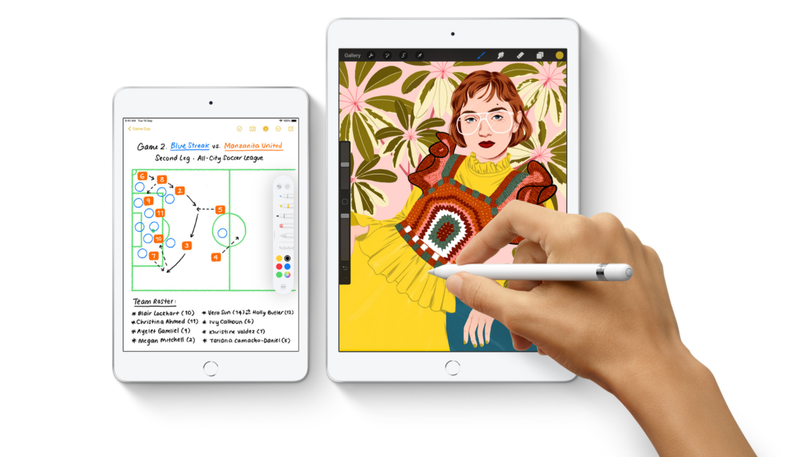
Input interfaces: point
Stylus‐based pointing
More accurate and more ergonomic
Touch‐based pointing
More intuitive and applicable for young children

Slide 9
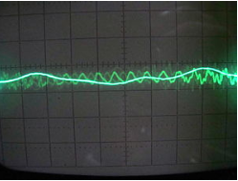
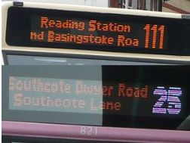
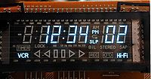
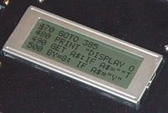
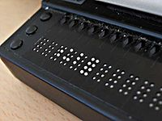
Development of display technology
A display device is an output device for presentation of information in visual or tactile form (Wikipedia)
Legacy display technologies:
Cathode ray tube (CRT); LED
Vacuum Florescent Display; TN LCD
Braille display

Slide 10
Introduction of display technology
Implication:
General: anything that is used to show text/images to users, such as
Teletype: paper, where the content is printed on it via the teleprinter.
Video displays: Blanking and rewriting of words and graphics, display much faster
…
Specifically, a display is a computer output surface and projecting mechanism that shows text and often graphic images to the computer user, using image projection technology. [*]
[*] https://whatis.techtarget.com/definition/display

Slide 11
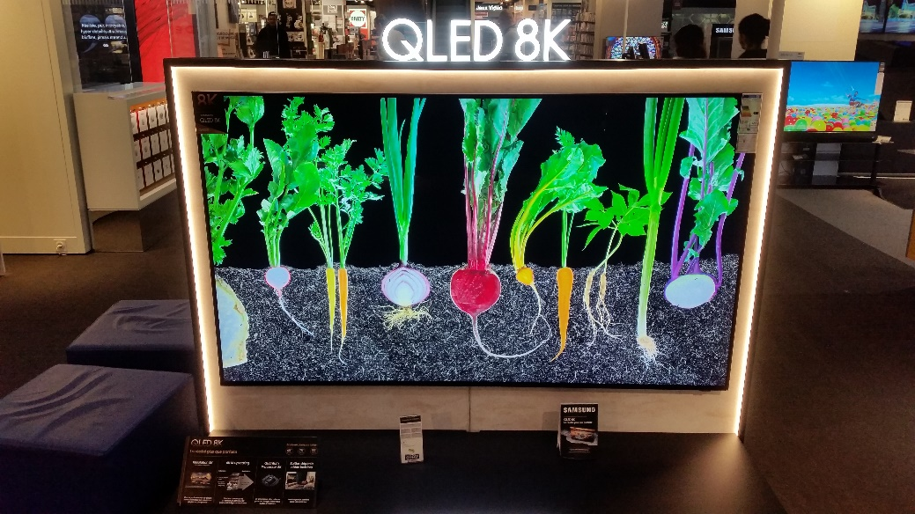
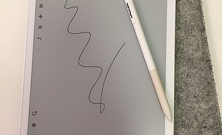
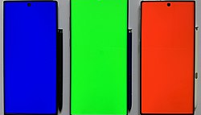
Development of display technology
Current generation:
Quantum dot LED
Electronic paper
AMOLED
……

Slide 12
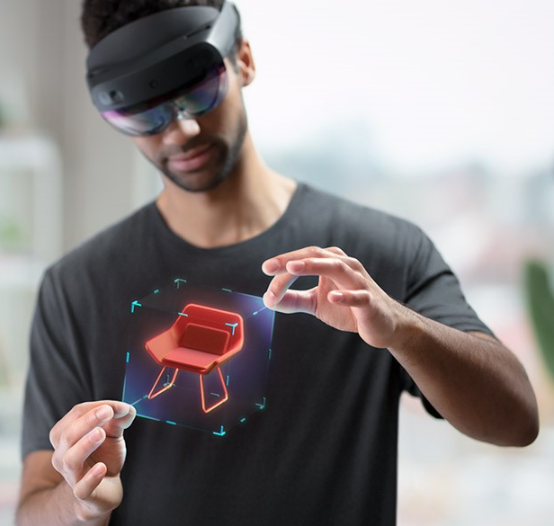
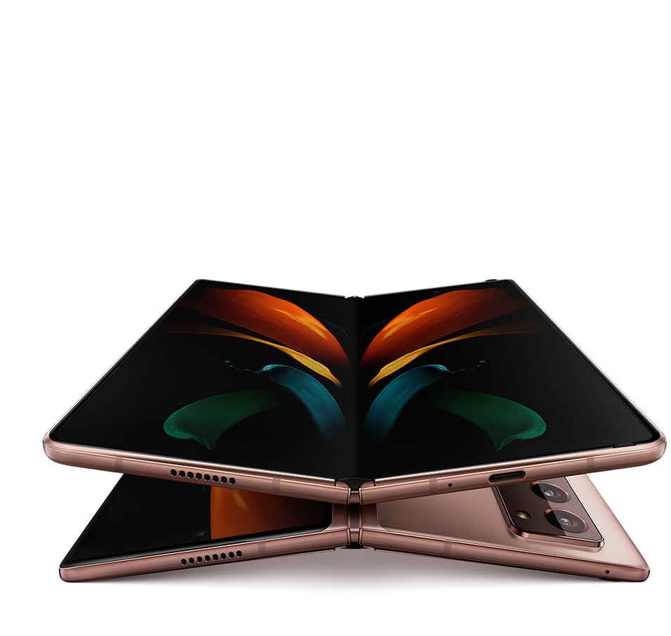
Development of display technology
Flexible display
Applications?
Virtual/Augmented reality headset

Slide 13
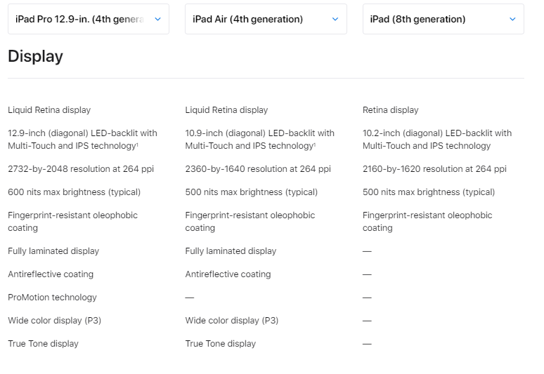
Display characteristics
Physical size: diagonal length of the display
Aspect ratio: ratio of the width to the height
Spatial resolution: number of pixels horizontally and vertically
Viewing angle: the widest angle deviation from the perpendicular direction

Slide 14
Display characteristics
Intensity:
Brightness vs. black level
Luminance of white pixels vs. black pixels
How to improve the effective contrast?
Dark environment: lower black level
Bright environment: greater black level

Slide 15
Display characteristics
The most important display characteristics under different scenarios:
Mobility
Small size, very high pixel density, very high brightness
Office work
Moderate size, smaller aspect ratio, higher brightness
Home entertainment
Large size, larger aspect ratio, larger color coverage

Slide 16
Advanced display technology -- Haptic
Vibration cues: provide simple tactile feedback
Gaming interfaces: joysticks, gamepads
Haptic touch feedback
Haptics - User Interaction - iOS - Human Interface Guidelines - Apple Developer
3D haptics: enable tactile sensation of virtual 3D shapes
https://www.youtube.com/watch?v=hB0TGrpSc4o
Sensable Phantom: https://www.youtube.com/watch?v=REA97hRX0WQ

Slide 17
Tactile mouse: https://www.youtube.com/watch?v=d6azZxAHI7s

Slide 18
 Sensable Phantom:
https://www.youtube.com/watch?v=REA97hRX0WQ

Slide 19
Advanced display technology -- Haptic
Haptics simulation
Primary human sense: touch
Motion simulation
Primary human sense: the sense of balance
Motion cueing techniques
Long accelerations: simulated by tilt to align virtual force with real gravity
Short accelerations: simulated by acceleration onset cueing
E.g. flight simulators
Further reading: https://www.smithsonianmag.com/innovation/heres-what-future-haptic-technology-looks-or-rather-feels-180971097/

Slide 20


